Slide 1
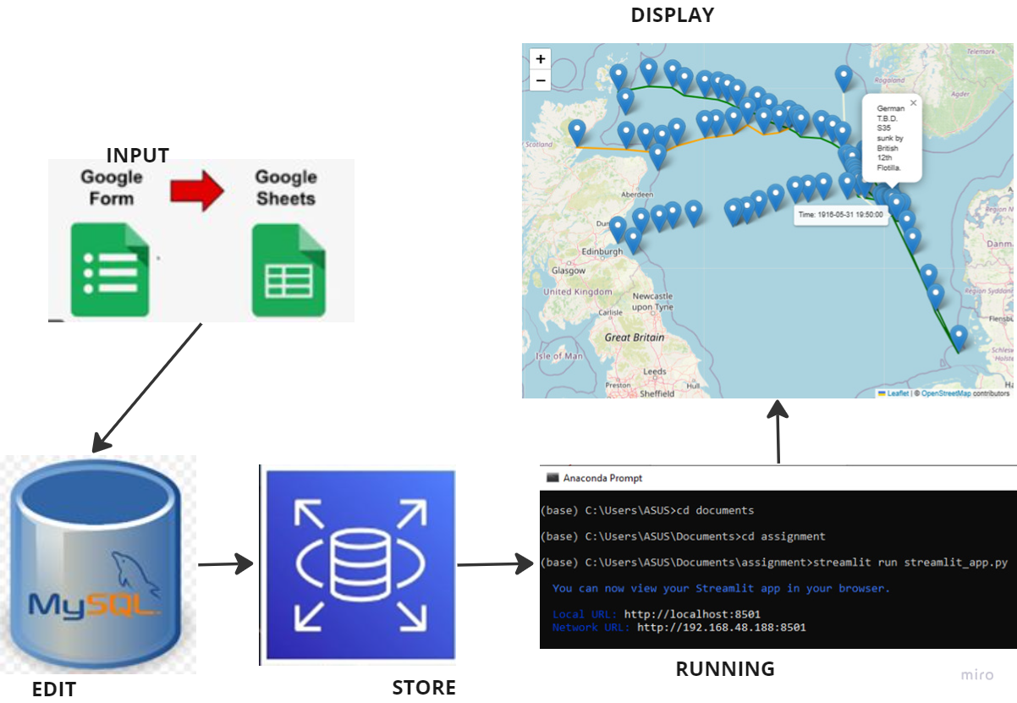
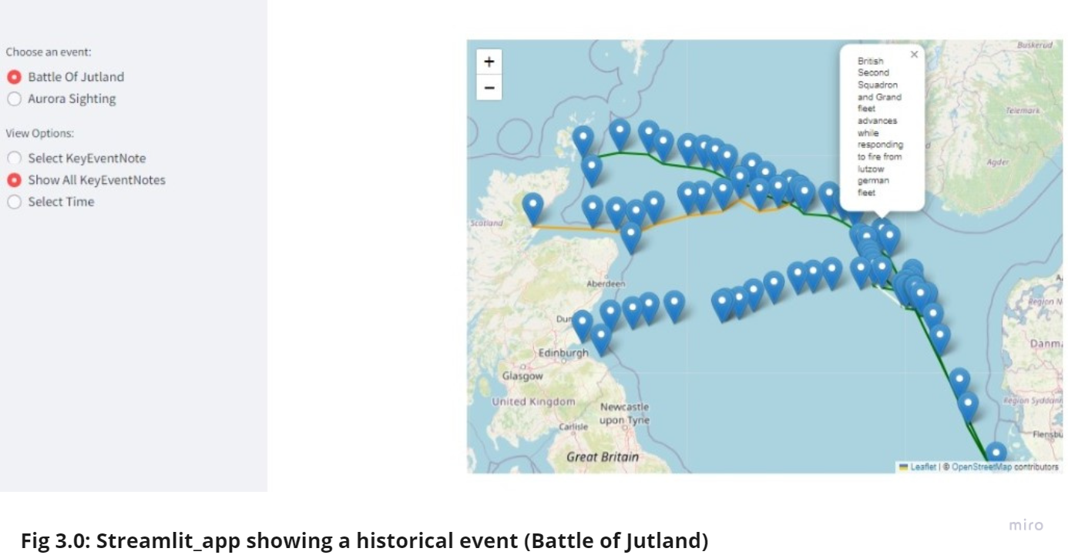
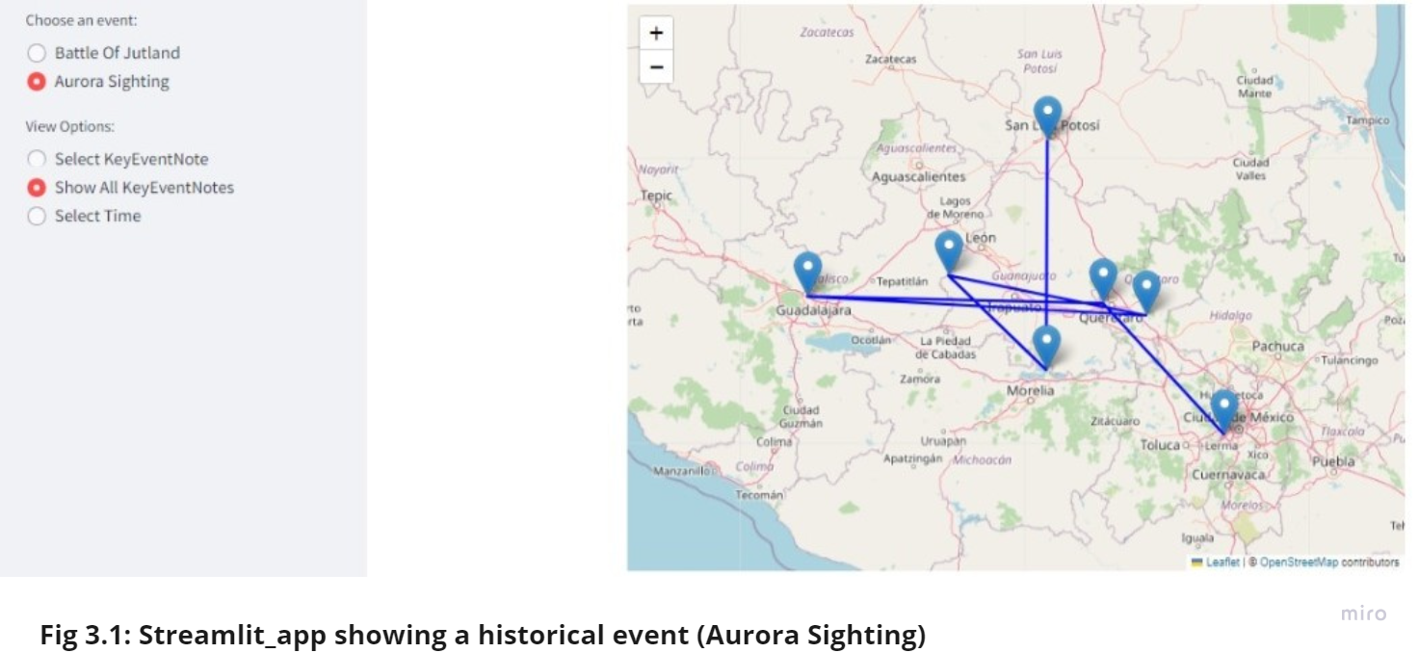
Database as a tool for Historical Simulation George Tunde
Advisor: Iain Murray
Introduction
Section 2
Historical simulation is vital across several fields. However, the efficacy of result generated is heavily dependent on the accuracy of the data presentation and analysis process. To address this, the project is geared toward gathering data from historical events, creation of database from the gathered information and utilizing it for simulating historical events.
OBJECTIVES
The project objectives includes:
Easy visualisation of historical events
User Interaction with historical events visualisation
Improvement of Simulation Accuracy Facilitation of historical data accessibility
System Architecture
Section 3
Database Selection
A relational database management system (RDBMS) was chosen due to its widespread use, robustness, flexibility. MySQL workbench which uses MySQL database management system, a graphical user interface (GUI) tool for MySQL that allows management of databases for the performance of various tasks was adopted as it allows seamless connection to the database created in the cloud.
Section 1
App Development and Technology:
Streamlit was used for the app development as it allows the transformation of Python scripts into interactive web apps. The developed app was deployed through the Anaconda prompt.
Why choose Streamlit?
Simple and Pythonic: Allows writing beautiful, easy to use and read phyton codes.
Fast, interactive prototyping: It allows users to interact with the app effectively.
Why choose Anaconda?
Environment Management: Helps to conveniently manage python environment.
Package Management: Helps to easily install Streamlit and any other dependencies required by the app.
Compatibility: Allows streamlit to run across different operating systems (Windows, macOS, Linux).
Discussion or conclusions
Various trade-offs were considered to balance competing priorities such as performance, complexity, and development time. For example, while a NoSQL database may offer better scalability for unstructured data, I opted for an RDBMS like MySQL for its robustness and familiarity.
Similarly, the decision to develop a web-based user interface over a desktop application was driven by considerations of accessibility and ease of deployment, despite potential trade-offs in performance for certain tasks.
Section 3
Problem Statement
This project addressed the inefficiency and inadequacy of traditional methods applied while managing historical data utilized for simulation purposes as spreadsheet-based systems lack scalability and can become cumbersome as data volume increases. Furthermore, quick retrieval and seamless integration of simulation models is well addressed.
Acknowledgements
My supervisor, Iain, my classmates, my family members and most importantly, God Almighty are deeply acknowledged.
MSc Data Science and Engineering, University of Dundee, 2023/2024

